Slide 1
Team Name:
DTVS ERRORS....!!
Team Number:36

Slide 2
College Name
JSPM Rajarshi shahu college of engineering , Tathawade

Slide 3
Problem statement:
PS14: E-Commerce Website for Bicycles with the following functionalities:

Slide 4
1. Cart Functionality
2. Wishlist Functionality. 3. User Login. 4. Order History 5. Product Filtering based on the
a) type of bicycle MTB, Hybrid, BMX b) Price of bicycle c) Size of Bicycle: Small, Medium, Large
Facility provided by website

Slide 5

Coding

Slide 6
Language use in source code:
The main important language are:.1HTML 2.Javascript
The HyperText Markup Language, or HTML is the standard markup language for documents designed to be displayed in a web browser. It can be assisted by technologies such as Cascading Style Sheets and scripting languages such as JavaScript

Slide 7
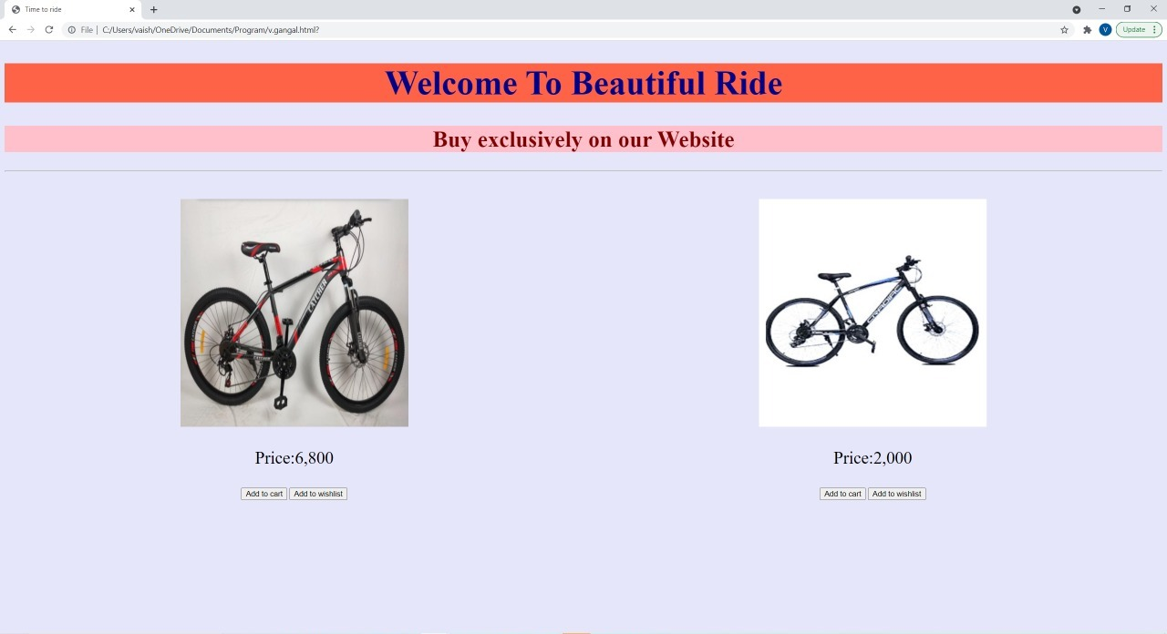
Day first:

Slide 8
Day second:
We create:
1.login page
2.filters or some changes in our website first page
3.How to use Firebase etc.

Slide 9
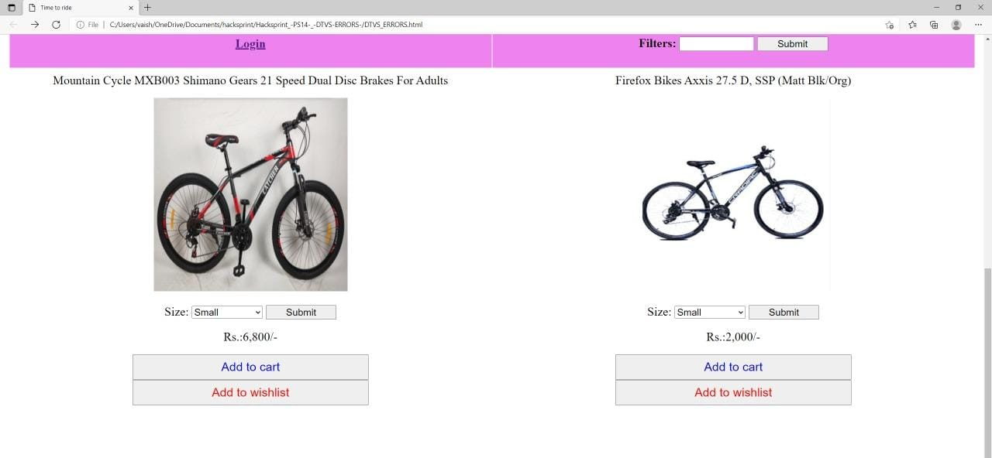
Day second:

Slide 10
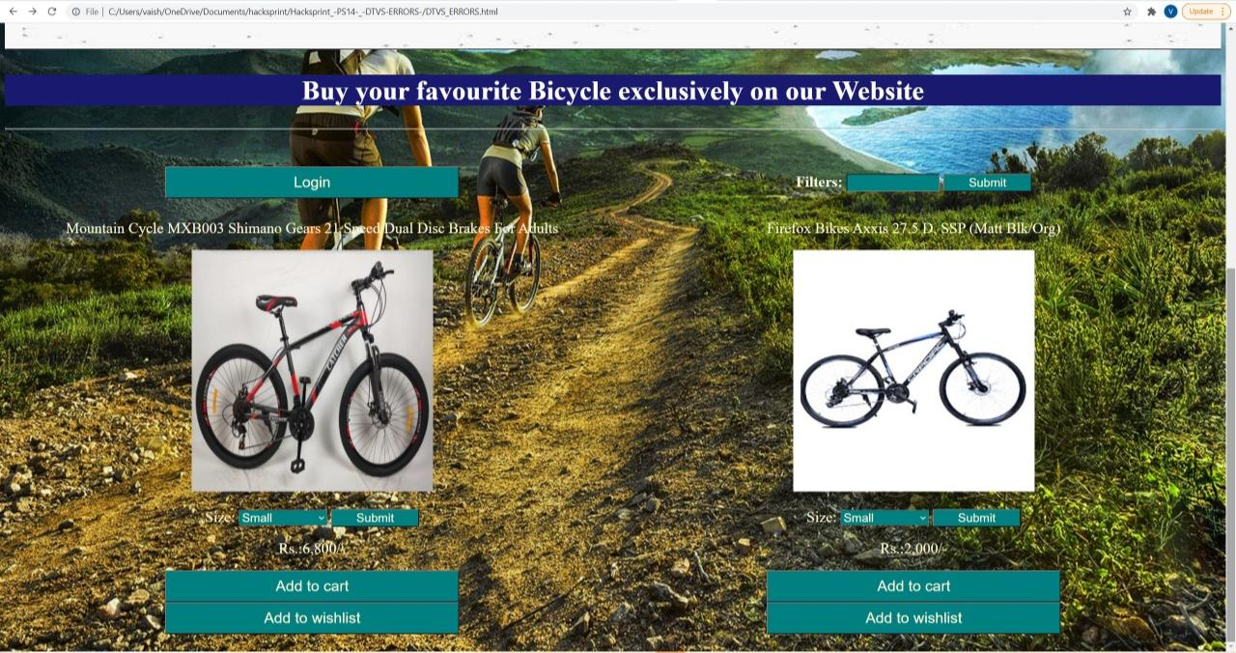
Day third:

Slide 11
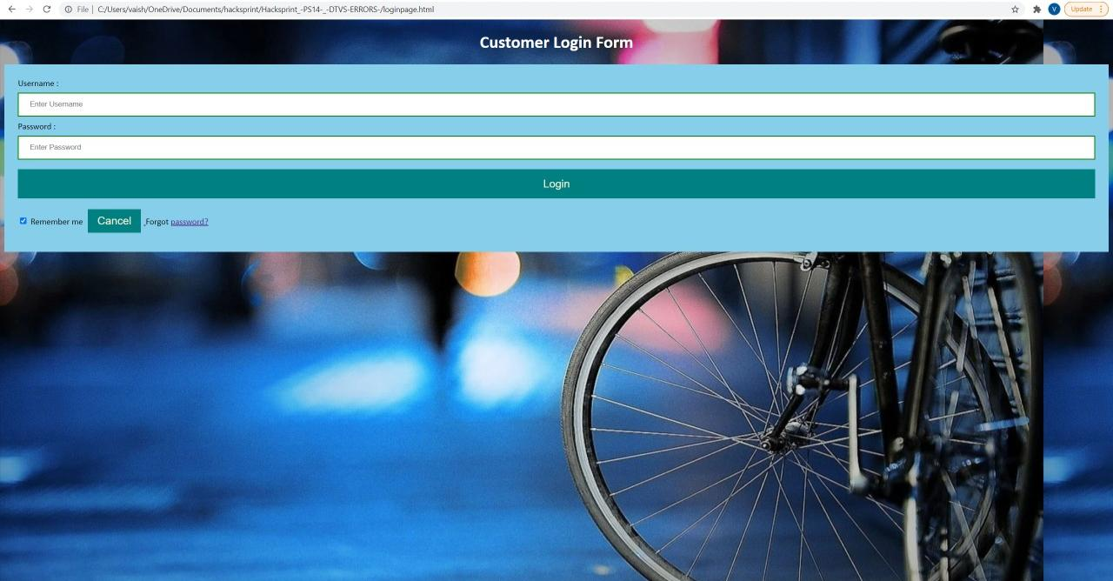
Customer login page:

Slide 12
Application:
1.The website is used for many purpose.
2.For shopping , starting new business etc.

Slide 13
Website importance:
Having a website and online presence strategy allows you to market your business online. A website is also important because it helps to establish credibility as a business. ... A website not only gives credibility but it also helps to give a positive impression that your company is bigger and more successful.

Slide 14
Suggestions given by mentor:
We don’t have any backend idea so, mentor suggest us Firebase which is really useful. Firebase is used for data storage purpose.
Mentor suggest us to change our website first page because it’s looks normal. So we work on it.

